Slide 1
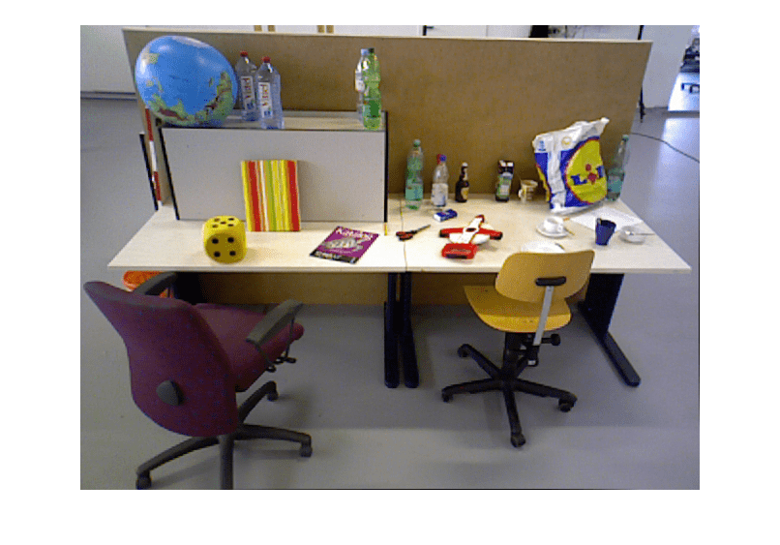

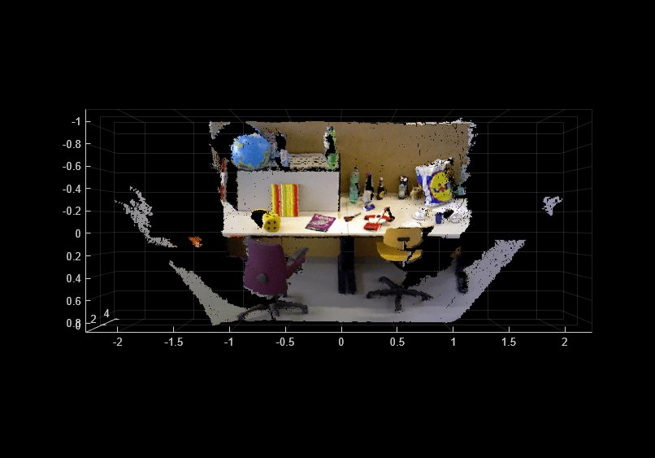
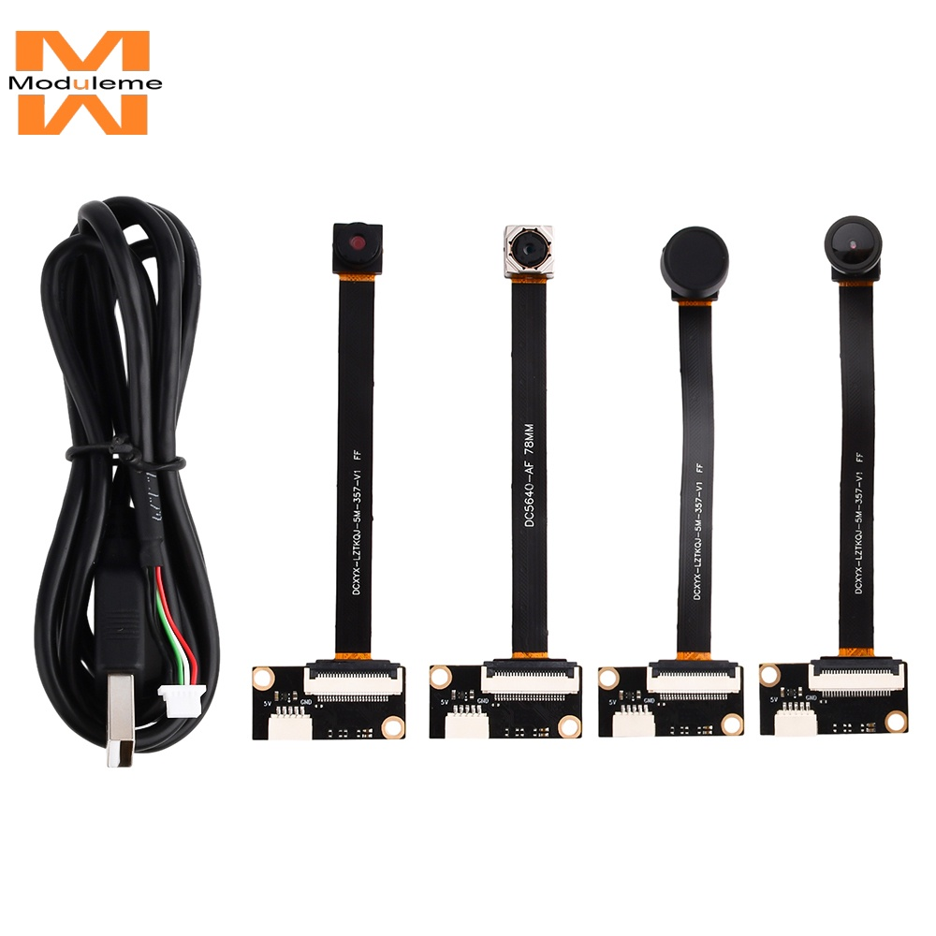
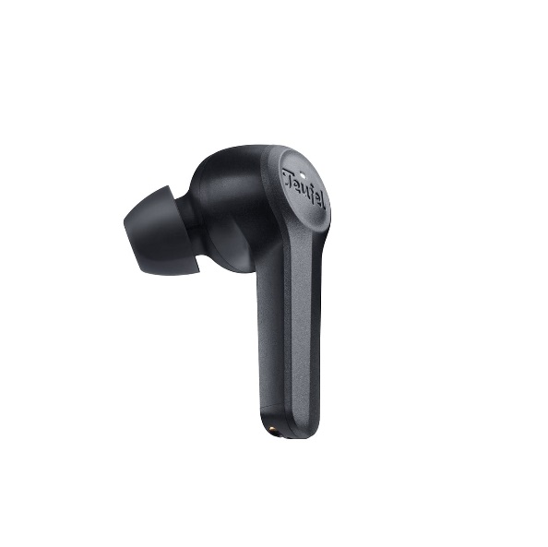
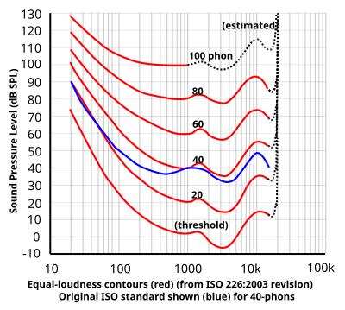
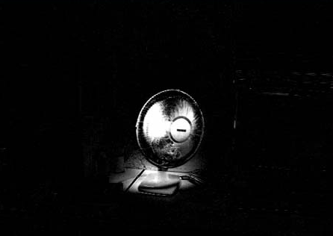

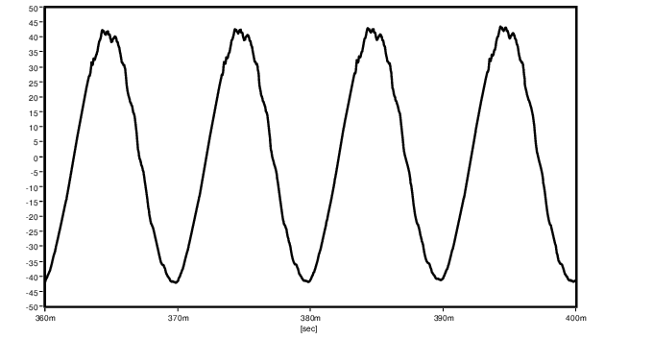
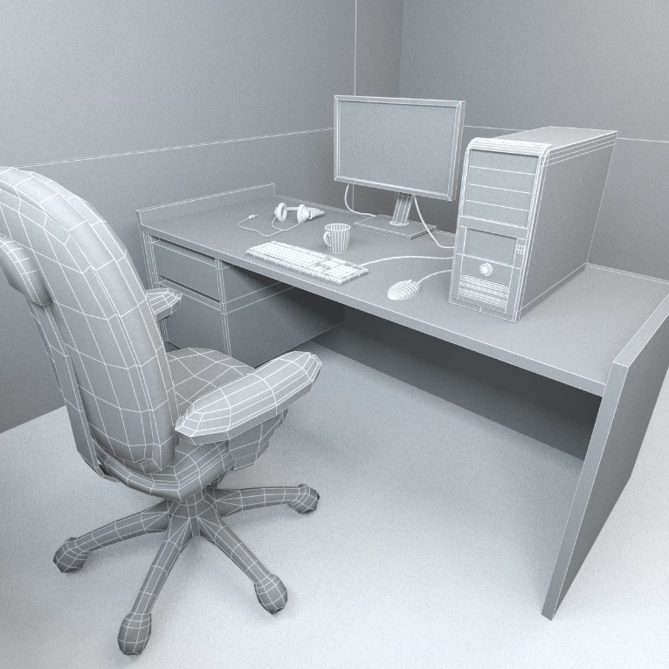
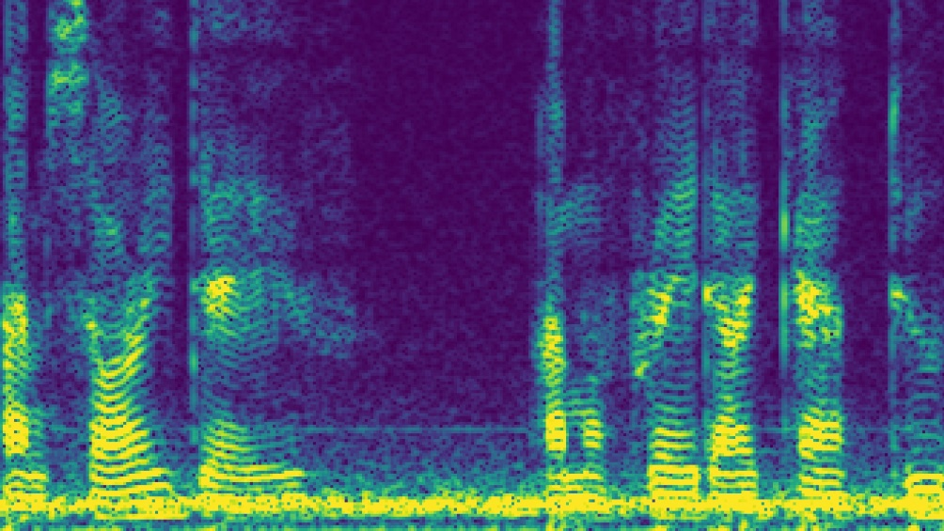
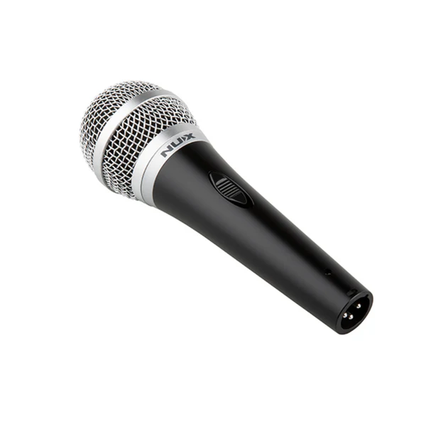
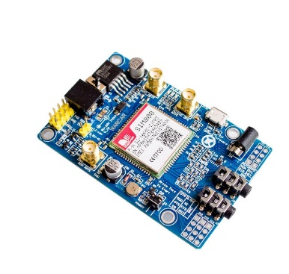
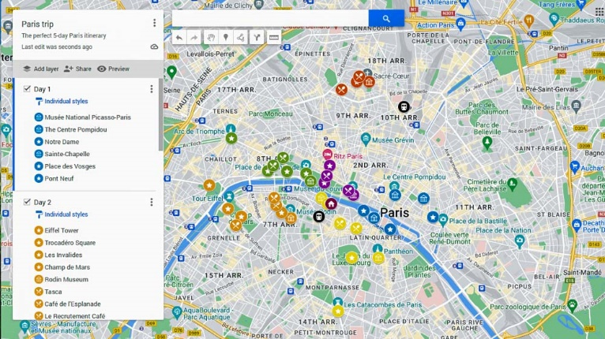


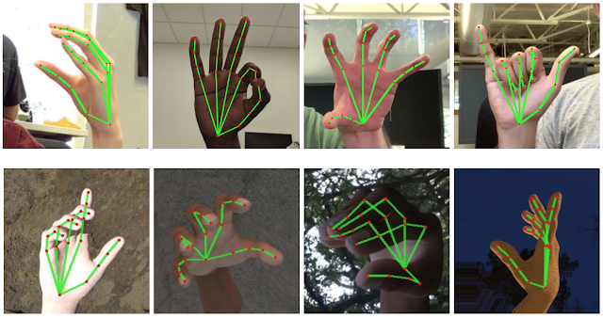
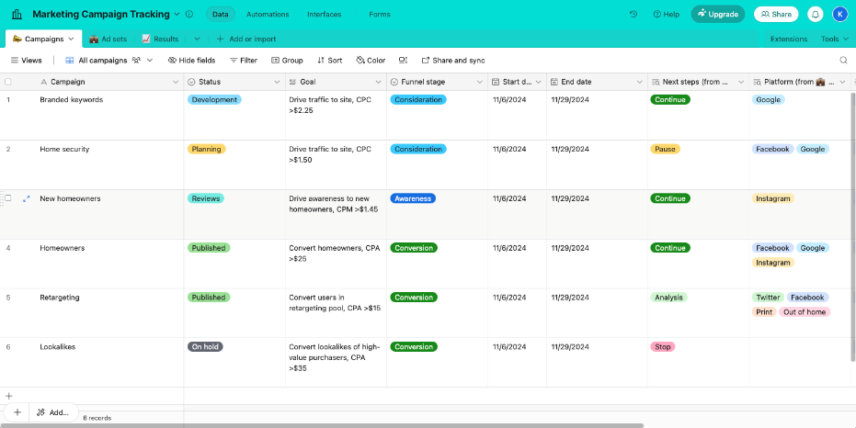
RASPBERRY PI 4 – Program in C++ OpenCV in Linux OS
STEP#2
Depth Calculation
STEP#3
Point Projection
STEP#1
Capturing
steroRectify()
reprojectImageto3D()
Environment
OV5640 5MP 160°
Camera
Depth Map
Point Cloud
STEP#9 Speaker
STEP#4
STEP#7
Scaling and fitting
Equal-loudness contour
Earphones
STEP#5
changes
Changed heatmaps
Reconstructed Waveform (Binaural/two-channeled)
User
STEP#6
STEP#8
Environmental Priority
iSTFT/iFFT addition
Spectrogram
Virtual Environment
Additional Information
GPS : Coordinates
Server API
Microphone
SIM808 with GPS
Virtual Physical World (Map)
Programs
Local LLMs, etc.
Instructions
External APIs
(Google, Meta, etc.))
Central Server
(DenoJS)
e.g: Hand Gesture Recognition
Virtual Digital World (OS)

Slide 2
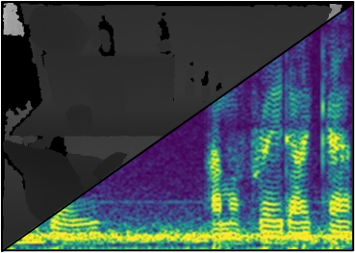
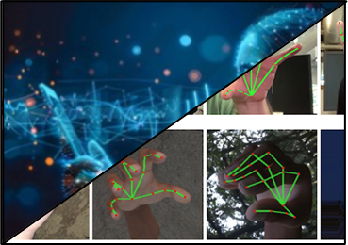

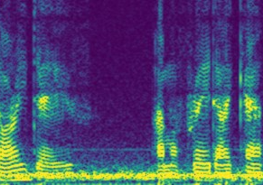
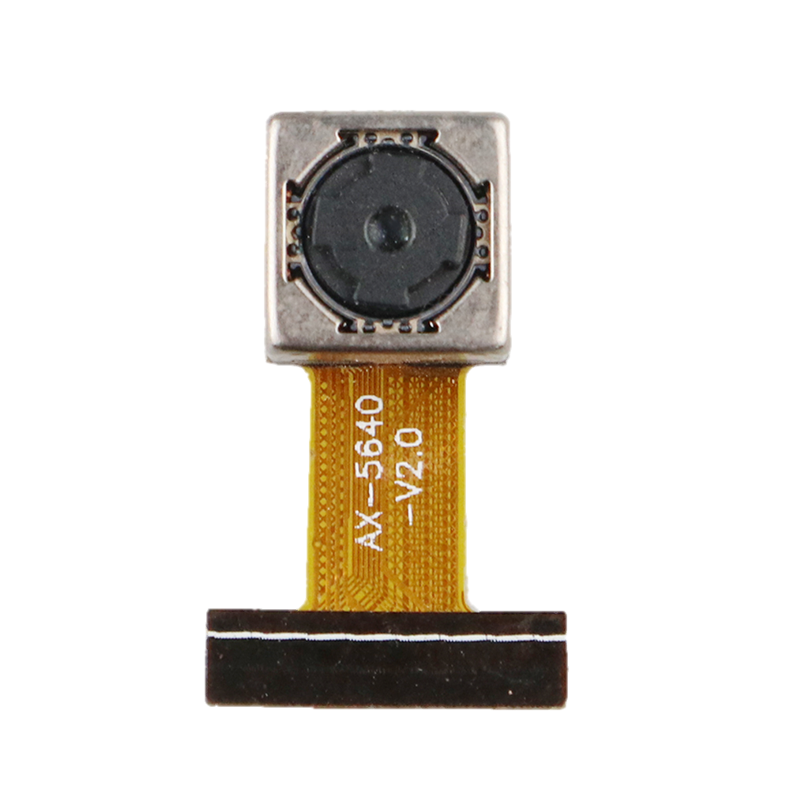



INPUT
PROCESS
OUTPUT
Earphone Binaural Speakers
Visual to Audio Substitution
(Custom Process)
OV5640 Camera
Hand Gesture Recognition
(MediaPipe)
Instructions
Earphone Microphone
Voice Command Recognition
(WhisperX)

Slide 3

INTERNET
BROWSING
SERVER
MANAGES
EXECUTES
DATABASES
LANGUAGE
MODELS
API REQUESTS
SMART HAT
CAPTURES
PARSES
GEOLOCATION
COMMANDS

Slide 4
INPUT | PROCESS | OUTPUT
2 Cameras : Images | Visual to Audio Substitution (Custom Algorithm) | Earphone Speakers: Audio
Camera | Hand Gesture Recognition (MediaPipe) | Command Instructions
Microphone | Voice Command Recognition (WhisperX) | Command Instructions

Slide 5
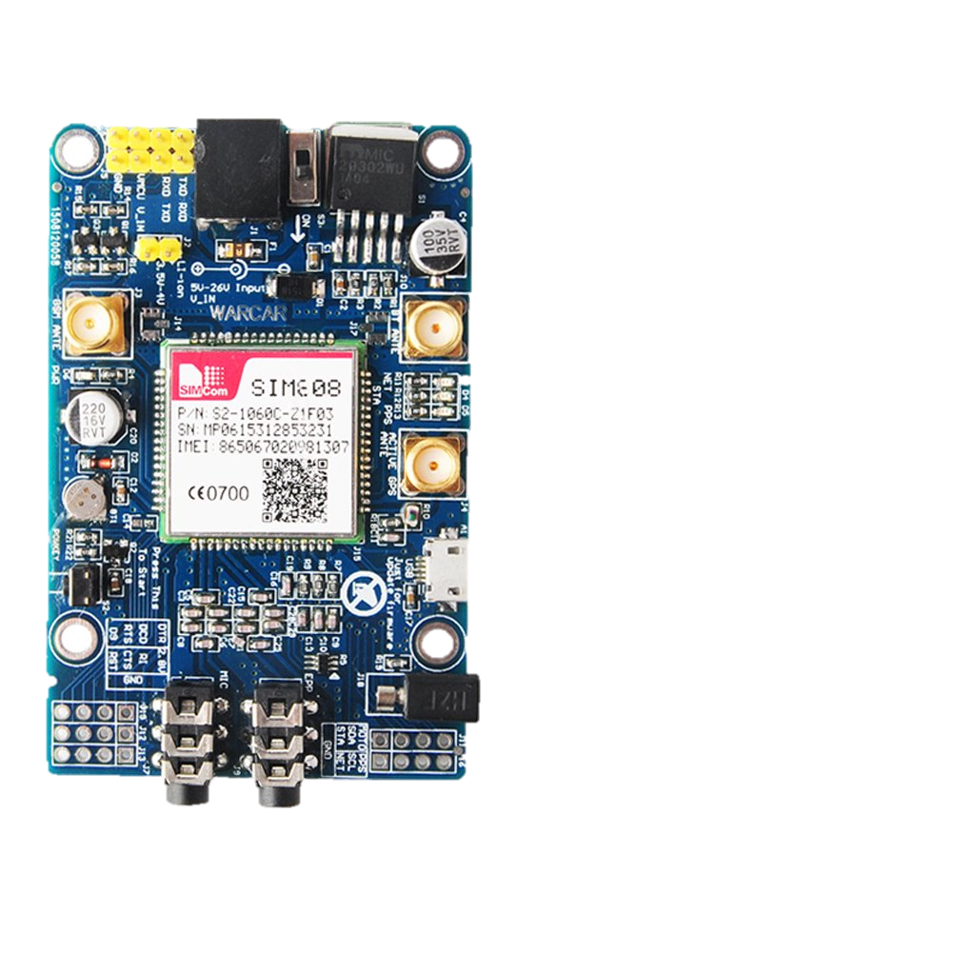
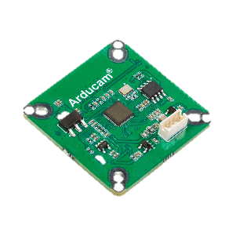
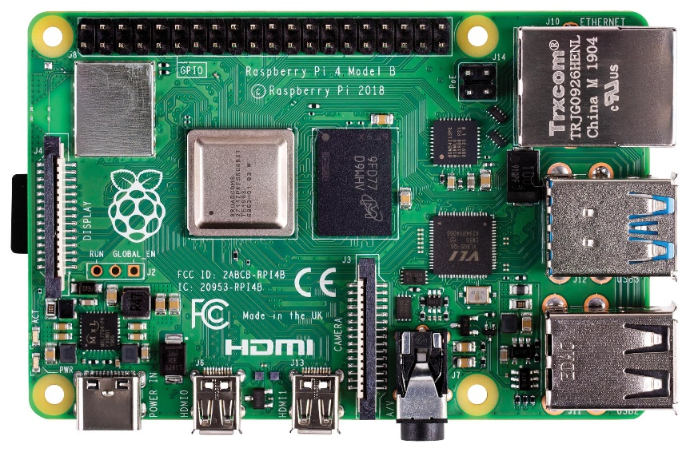
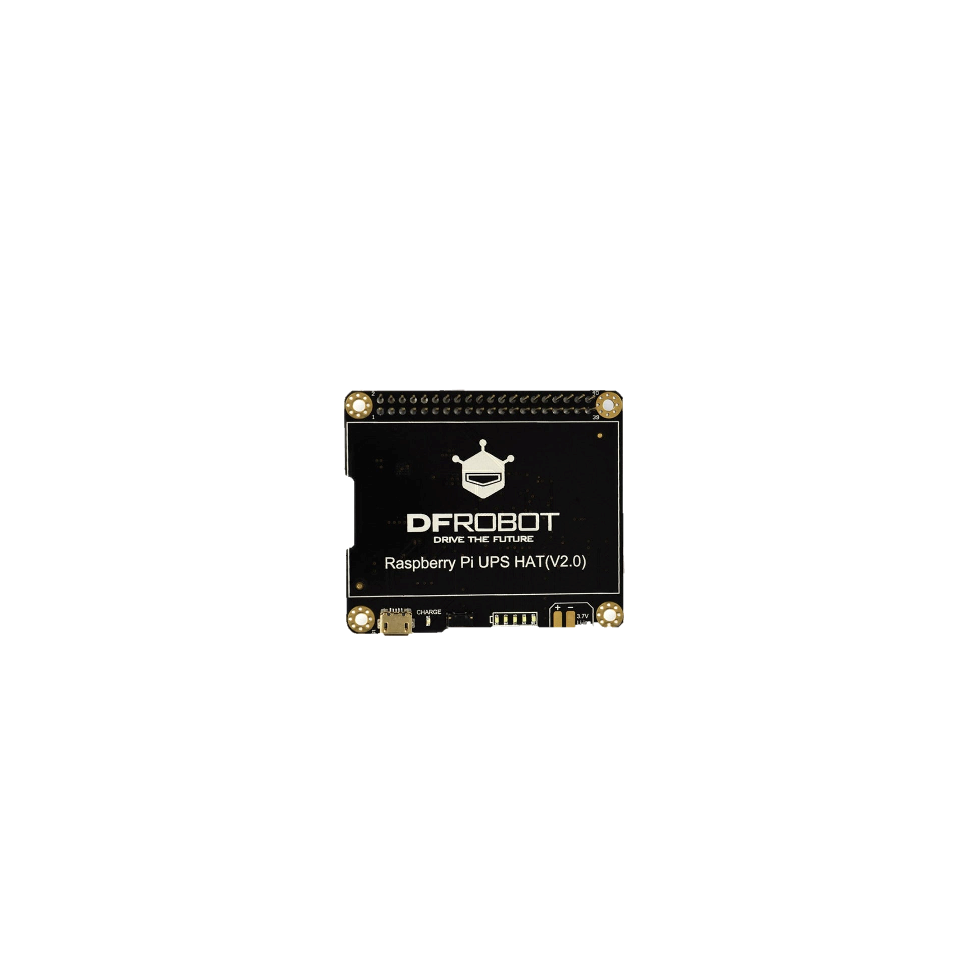
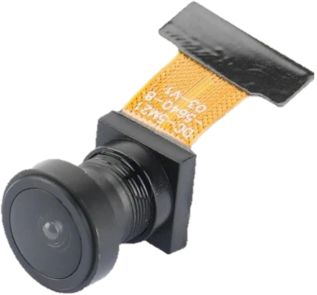
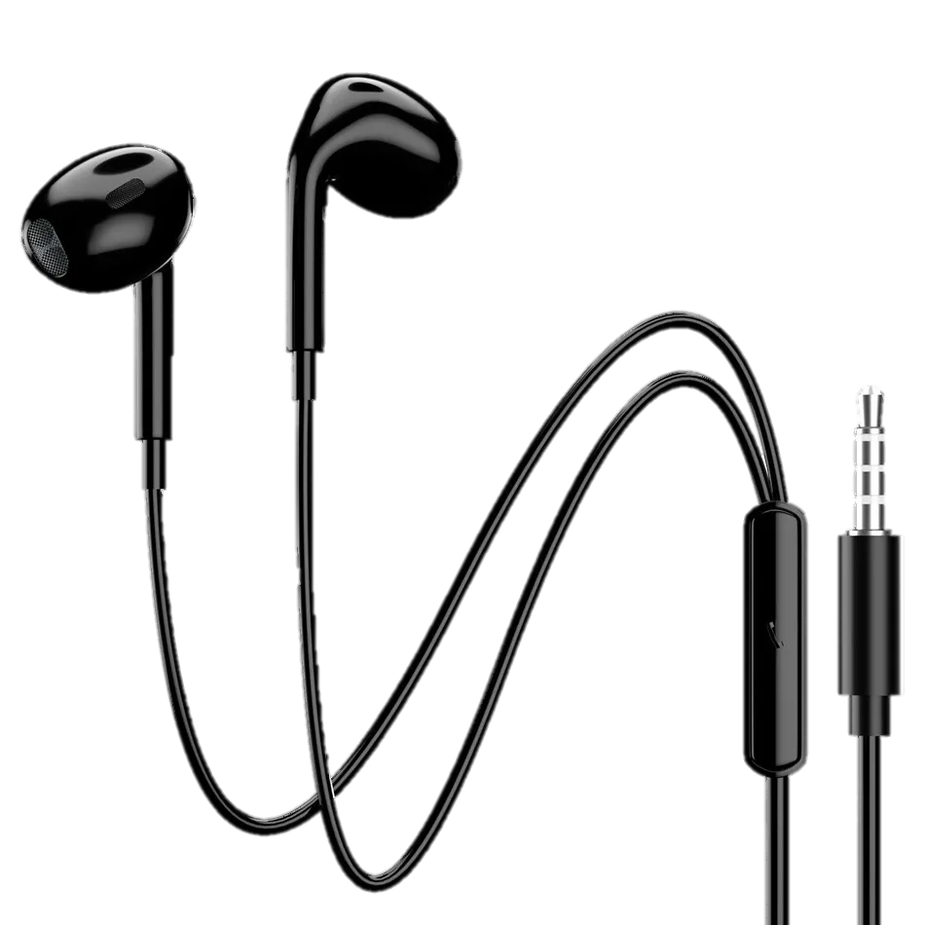
Microcontroller
RASPBERRY PI 4
Internet & GPS
SIM808
MIPI CSI-2 TO USB
Power Supply
UPS HAT
Camera
OV5640
Speaker & Microphone
Ear phone

Slide 6
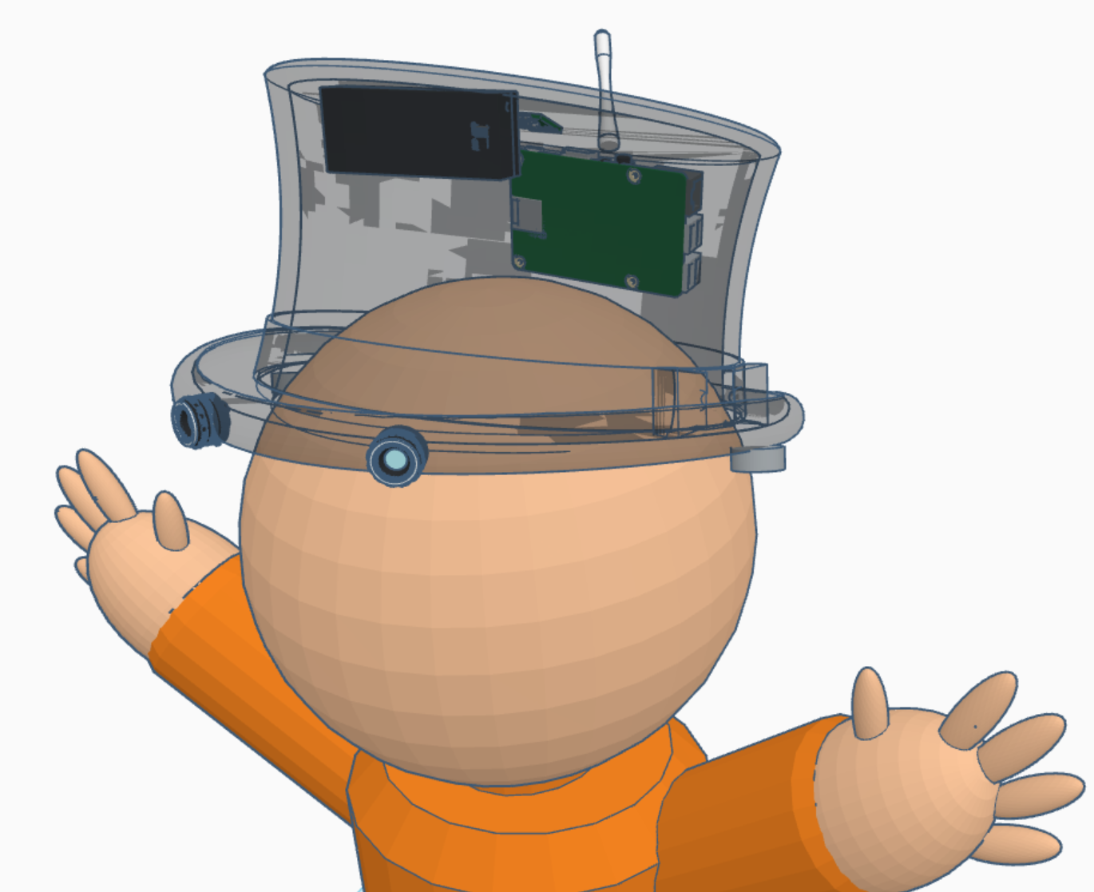
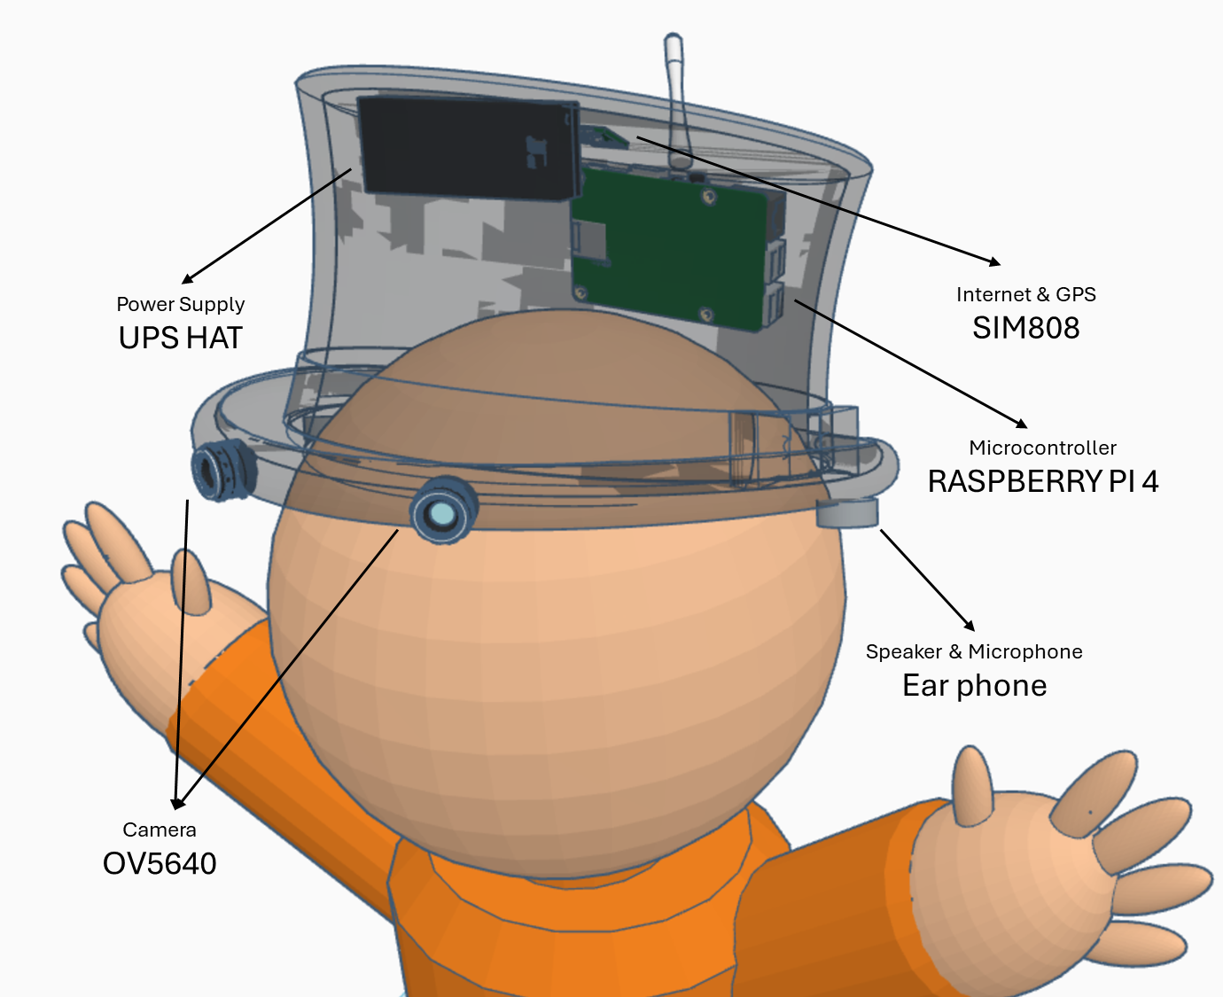
Power Supply
UPS HAT
Internet & GPS
SIM808
Microcontroller
RASPBERRY PI 4
Speaker & Microphone
Ear phone
Camera
OV5640

Slide 7




Converts 3D visual data into sound
Modular system unique to everyone
Filter only necessary data
Information
Process 3D Space
Into Audio
Instructions
System
forward the progress of sensory substitution devices and attempt to see if we could overcome the issues they faced in societal wide implementation

Slide 8



Converts 3D visual data into sound
Modular system unique to everyone
Information
Process 3D
space into audio
Filters only
necessary data
Instructions
Based on Brain visual techniques
Applications allow custom controls
Visual movement is proportional to depth at focus point, but is inversely proportional to peripheral changes
Audio spectrum is unequally scaled based on the Equal-loudness contour
Focus radius is proportional the frequency spectrum, but is inversely proportional to frequency detail
Hand gestures to navigate the system (hand gestures detected by camera)
Virtual world where the physical and digital interfaces meet (google maps and actual physical map)
Broader adaption through demand from non-impaired users, supporting distribution and sustainability
forward the progress of sensory substitution devices and attempt to see if we could overcome the issues they faced in societal wide implementation

Slide 9
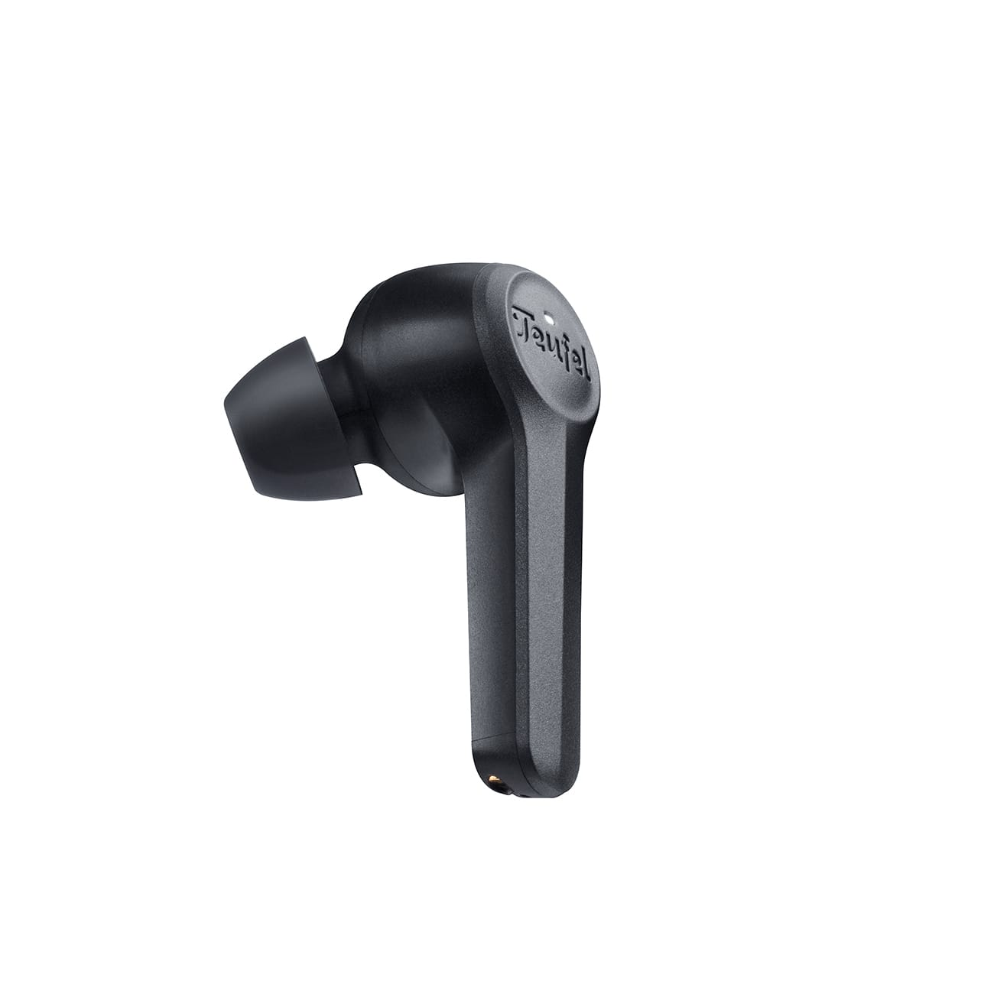

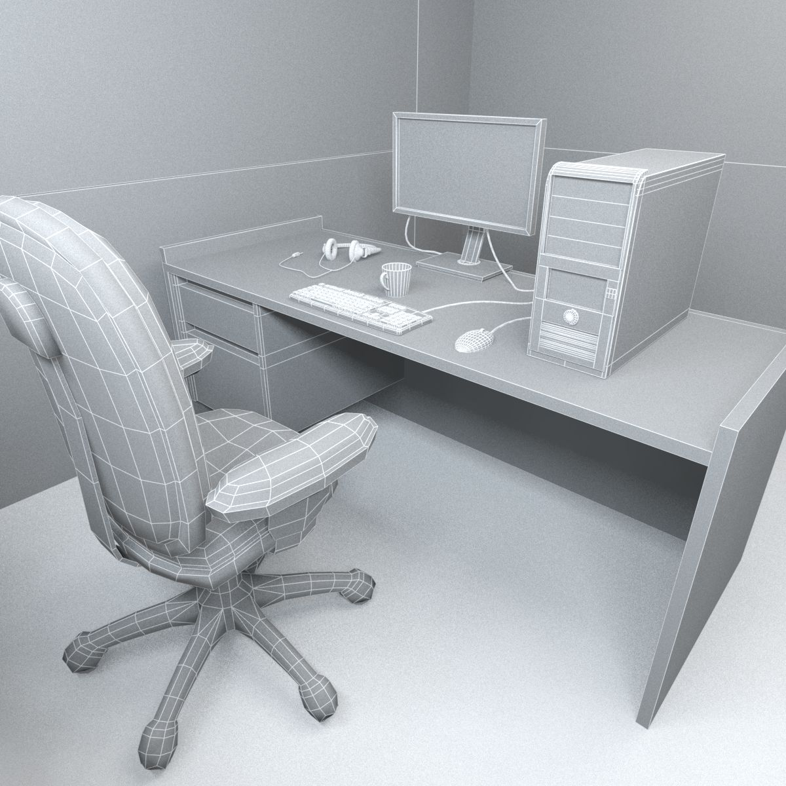



Applications
Virtual Physical Map
Selective Spectrogram Audio
10 cm
Virtual Physical Map
2 OV5640 Camera: 5MP 160°
Environment
Point Cloud Projection
Hand Gesture Recognition
Voice Recognition
Virtual Physical Map
Server API

Slide 10
Power Supply
25W UPS HAT
Internet & GPS
SIM868
Microcontroller
RASPBERRY PI 5
Speaker & Microphone
Ear phone
Camera
OV5640

Slide 11
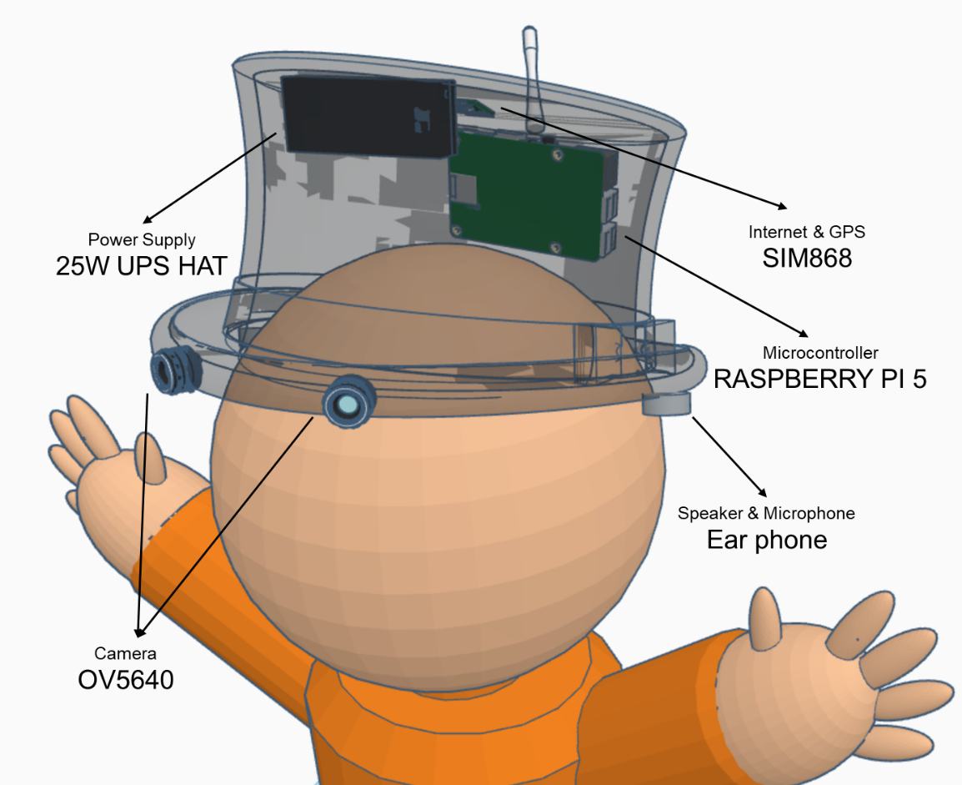
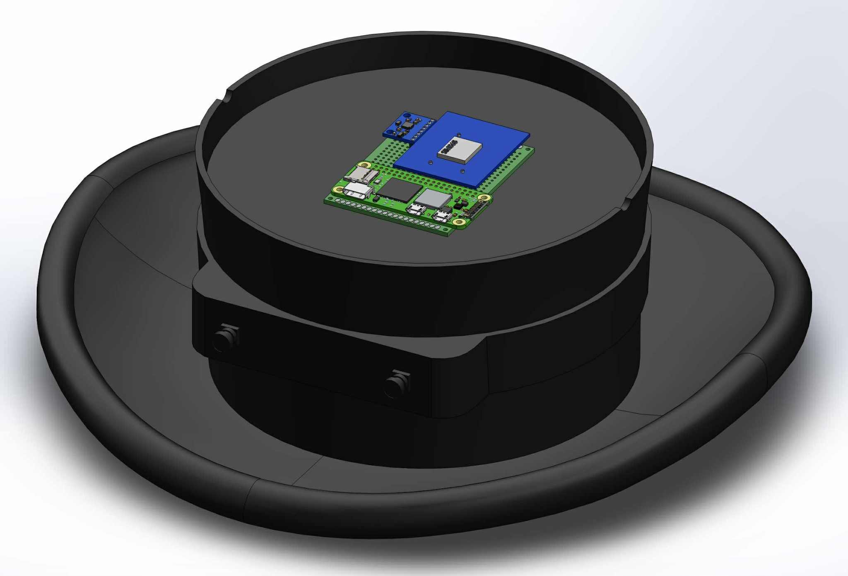
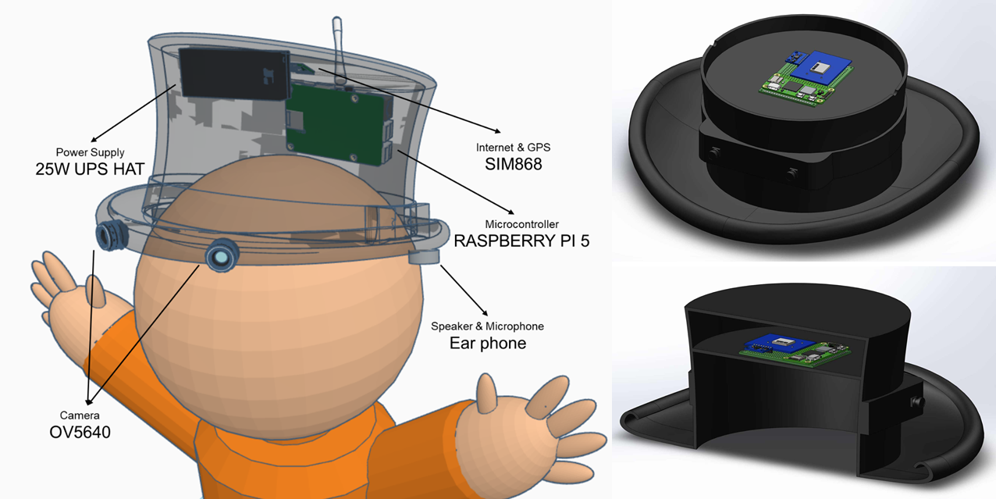
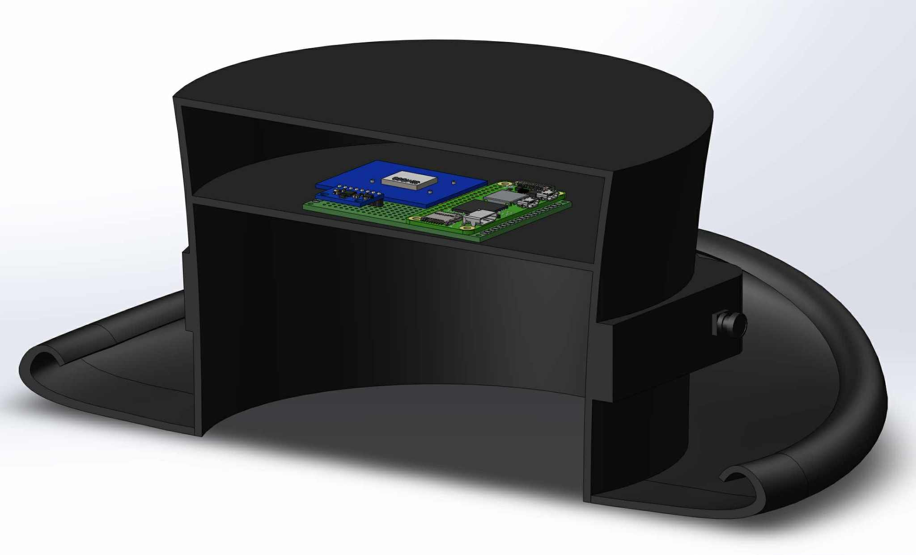

Slide 12
INPUT
Visual information from the stereo camera
User hand gesture instructions
GPS Location
IMU Orientation
PROCESS
Human Sensory Emulation (Visual)
Modular Operating System (Applications)
AIoT Server API protocols
OUTPUT
Binaural audio indicating environmental information
Virtual Map modifications
FEEDBACK
Point cloud projection correction
Server API Update

Slide 13
INPUT
Hardware:
Raspberry PI 5
25W UPS module
OV5640 Camera
Binaural Earphone
SIM868 with GPS
MPU 6050
Software:
GitHub
Microsoft Word
Linux
DenoJS
VSCode
Wireless Connectivity:
2/3G or Wi-Fi
PROCESS
Problem Statement
Literature Review (RRL)
Prototyping
Requirements
Designing
Development
Refinement
Implementation
OUTPUT
Development of Wearable Navigation Aid using AIoT for the Visually Impaired
FEEDBACK

Slide 14
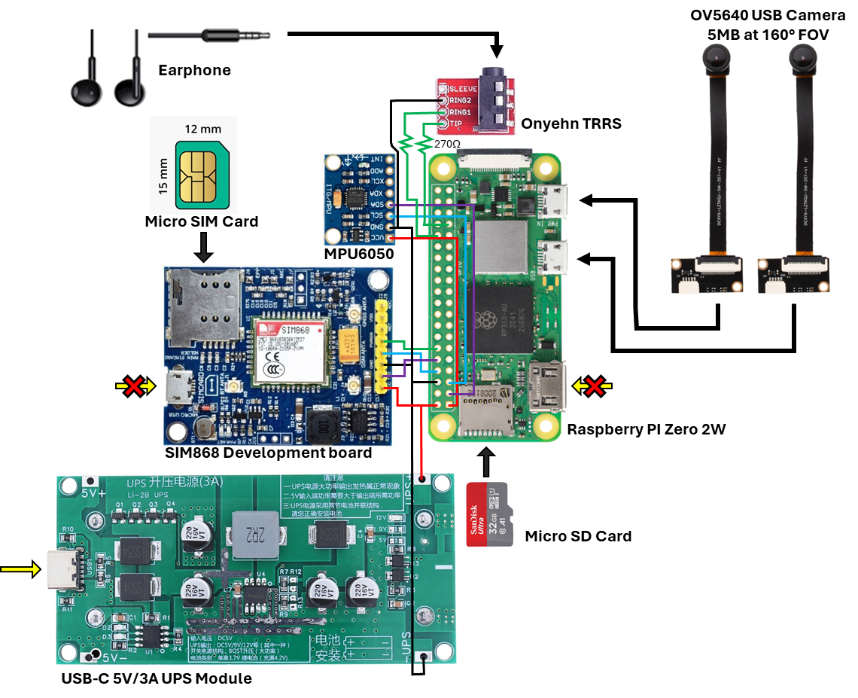
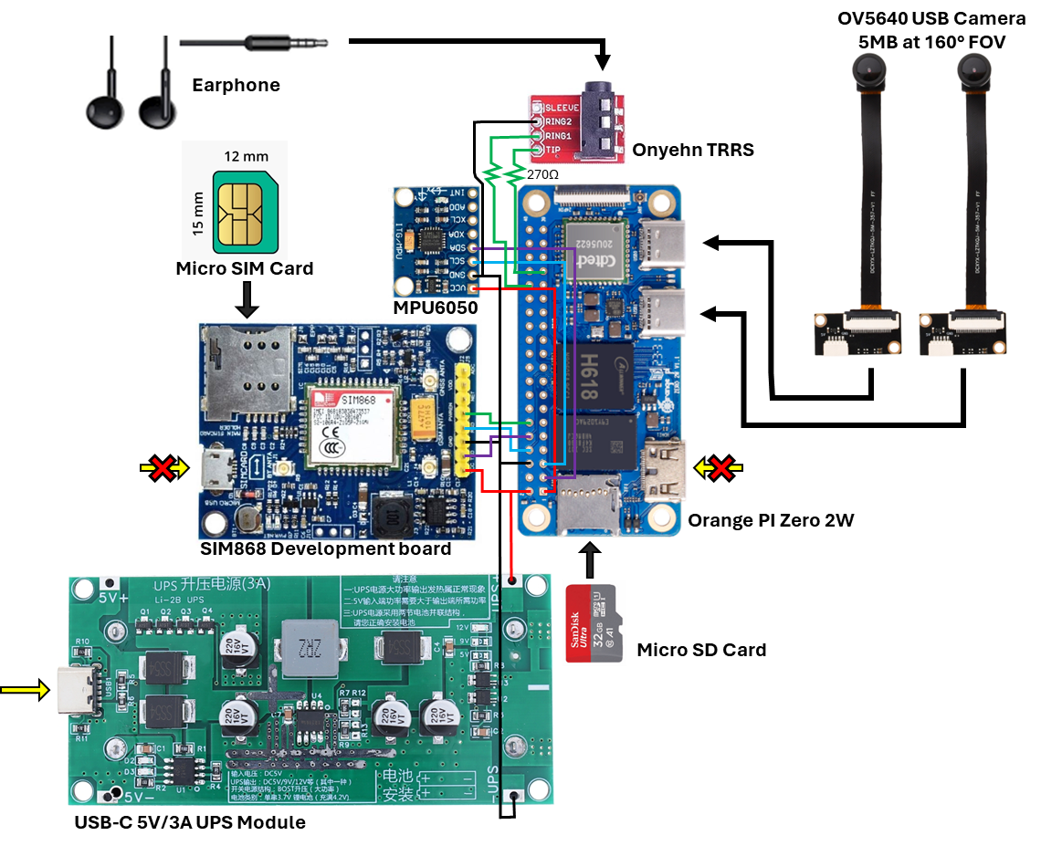
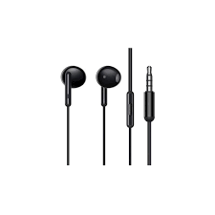
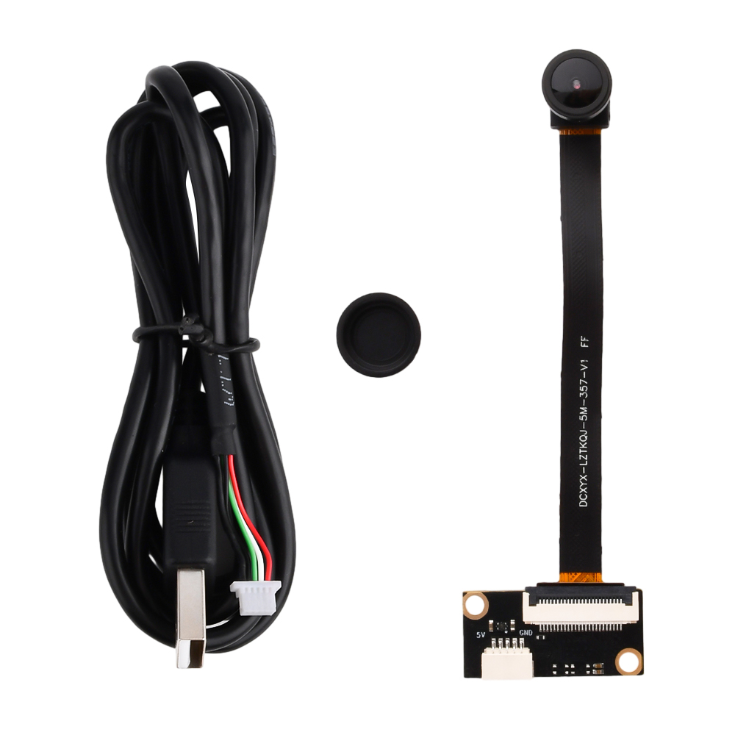
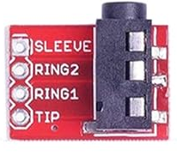
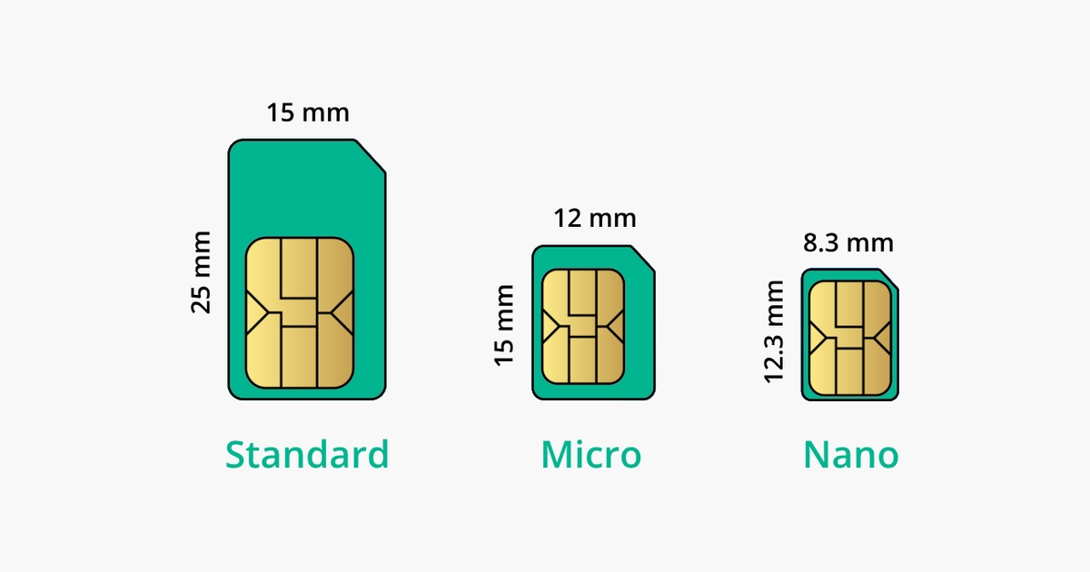
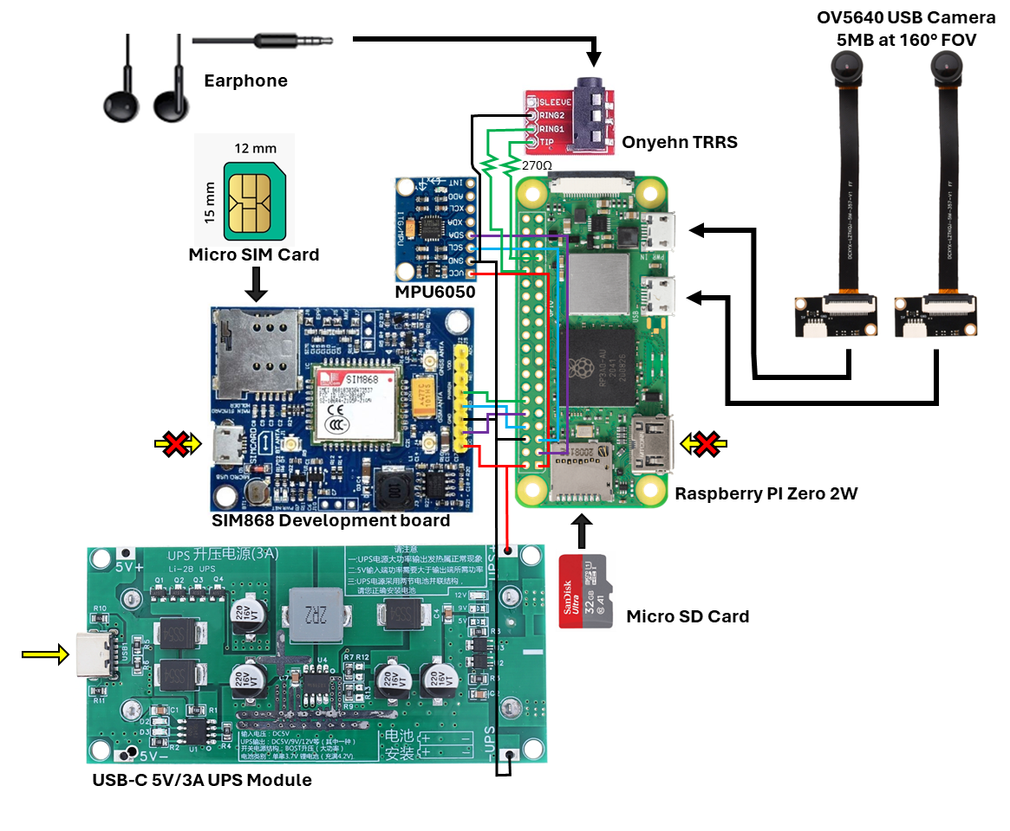
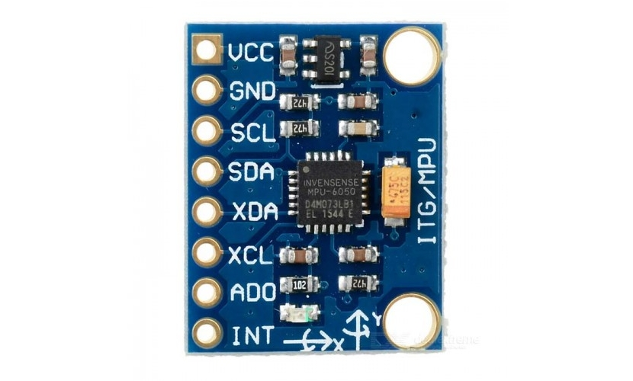
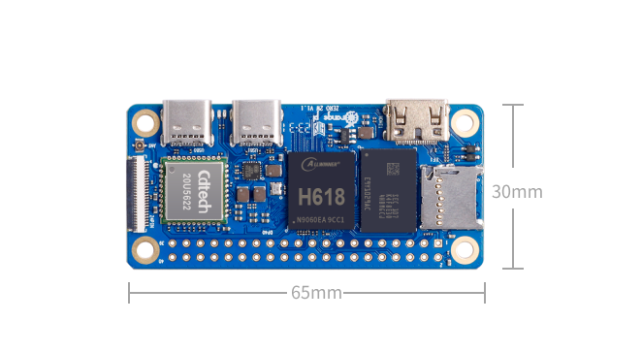
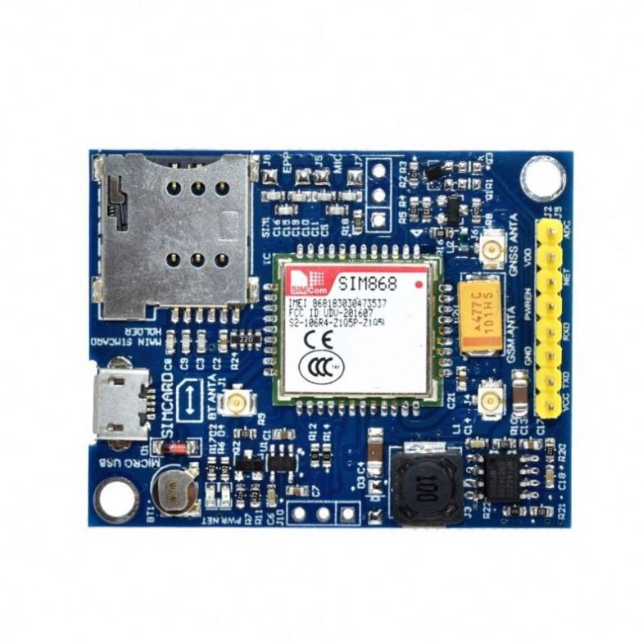
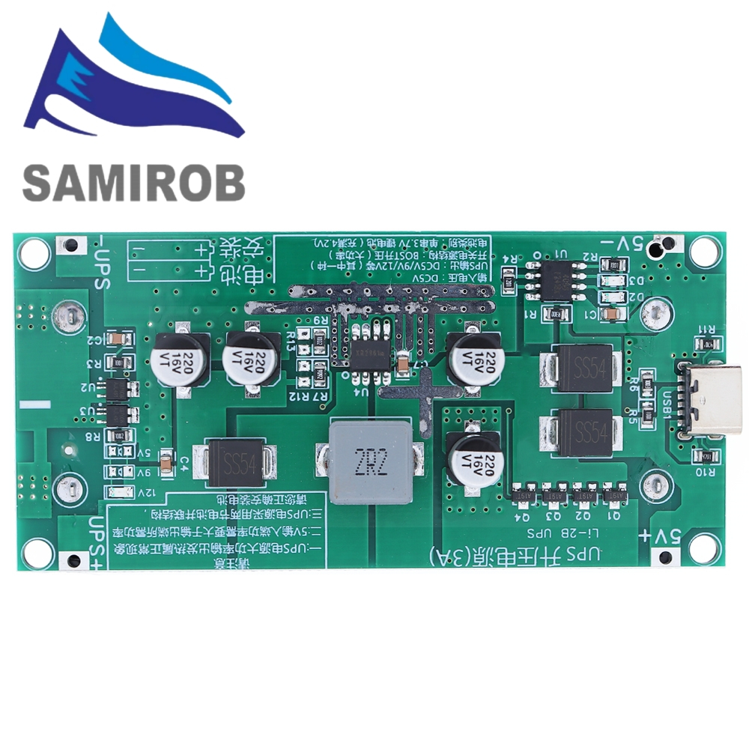
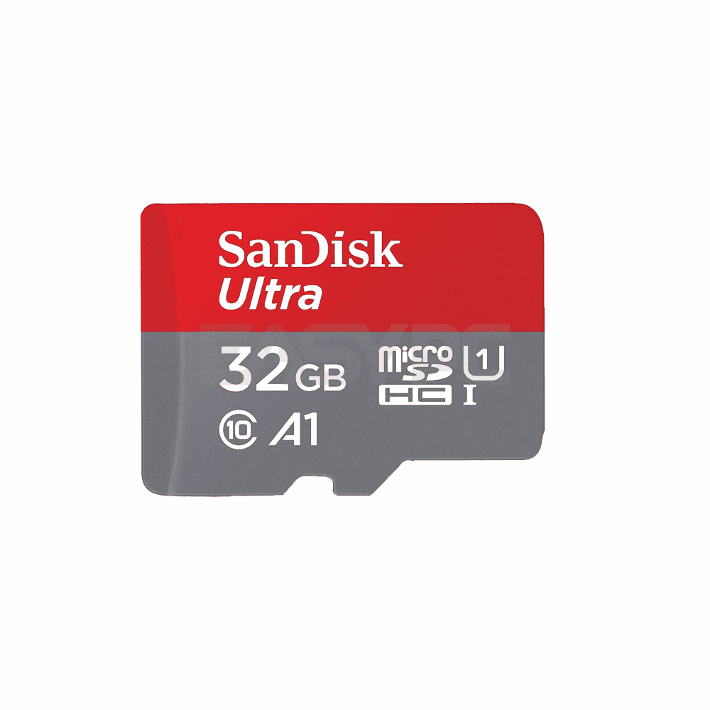
OV5640 USB Camera
5MB at 160° FOV
Earphone
Onyehn TRRS
270Ω
Micro SIM Card
MPU6050
Orange PI Zero 2W
SIM868 Development board
Micro SD Card
USB-C 5V/3A UPS Module

Slide 15
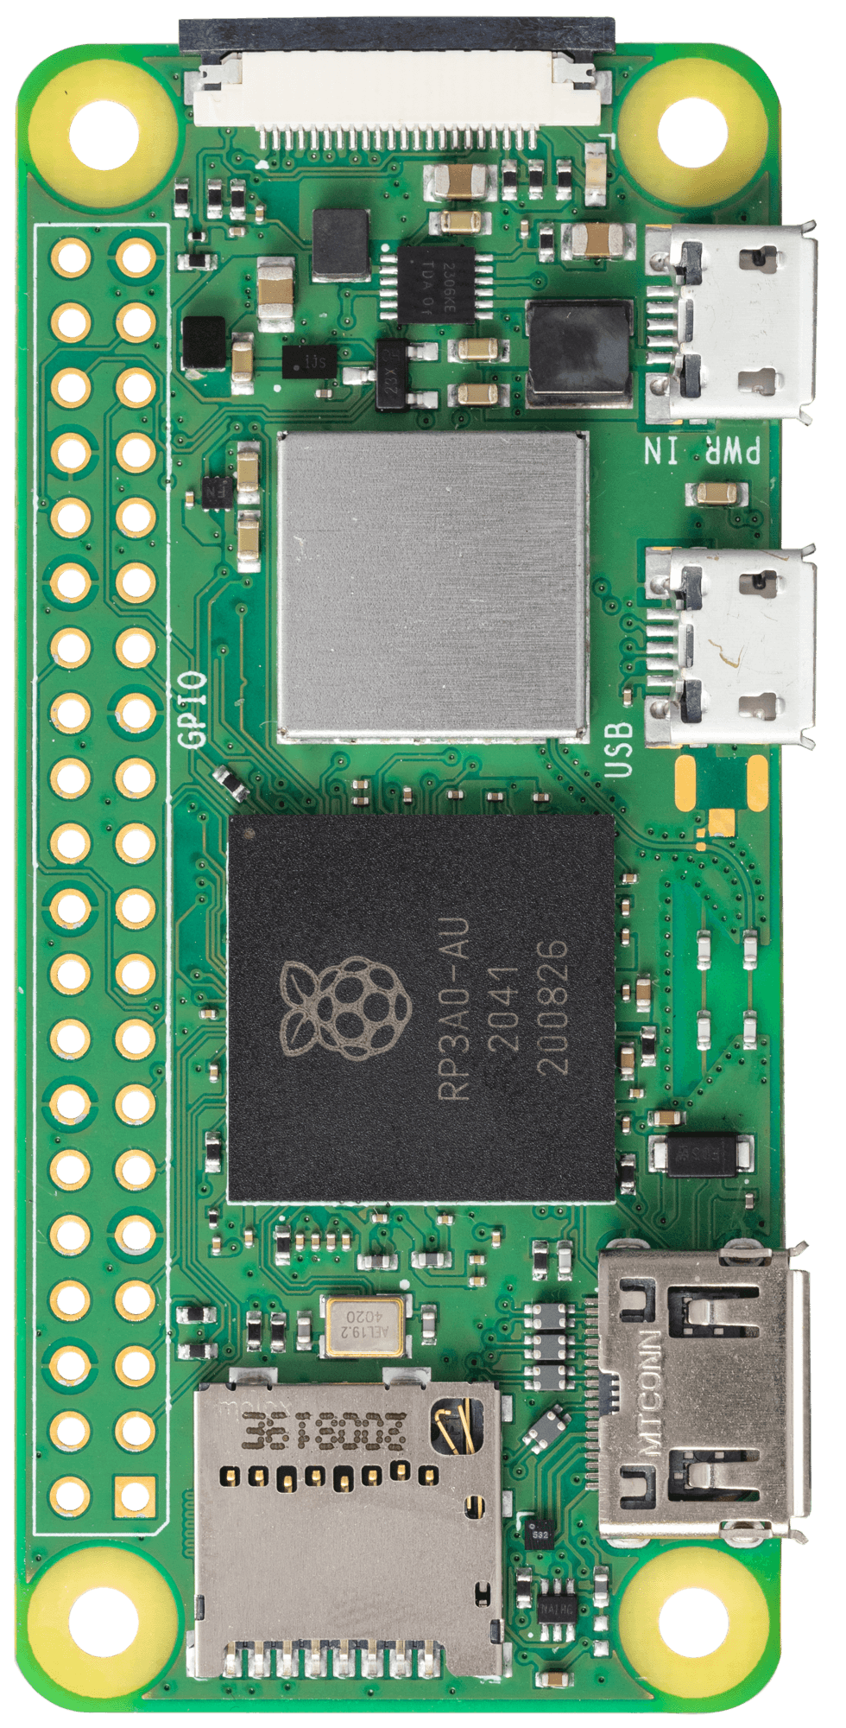

Slide 16
SMART HAT
6 cm
2 cameras

Slide 17
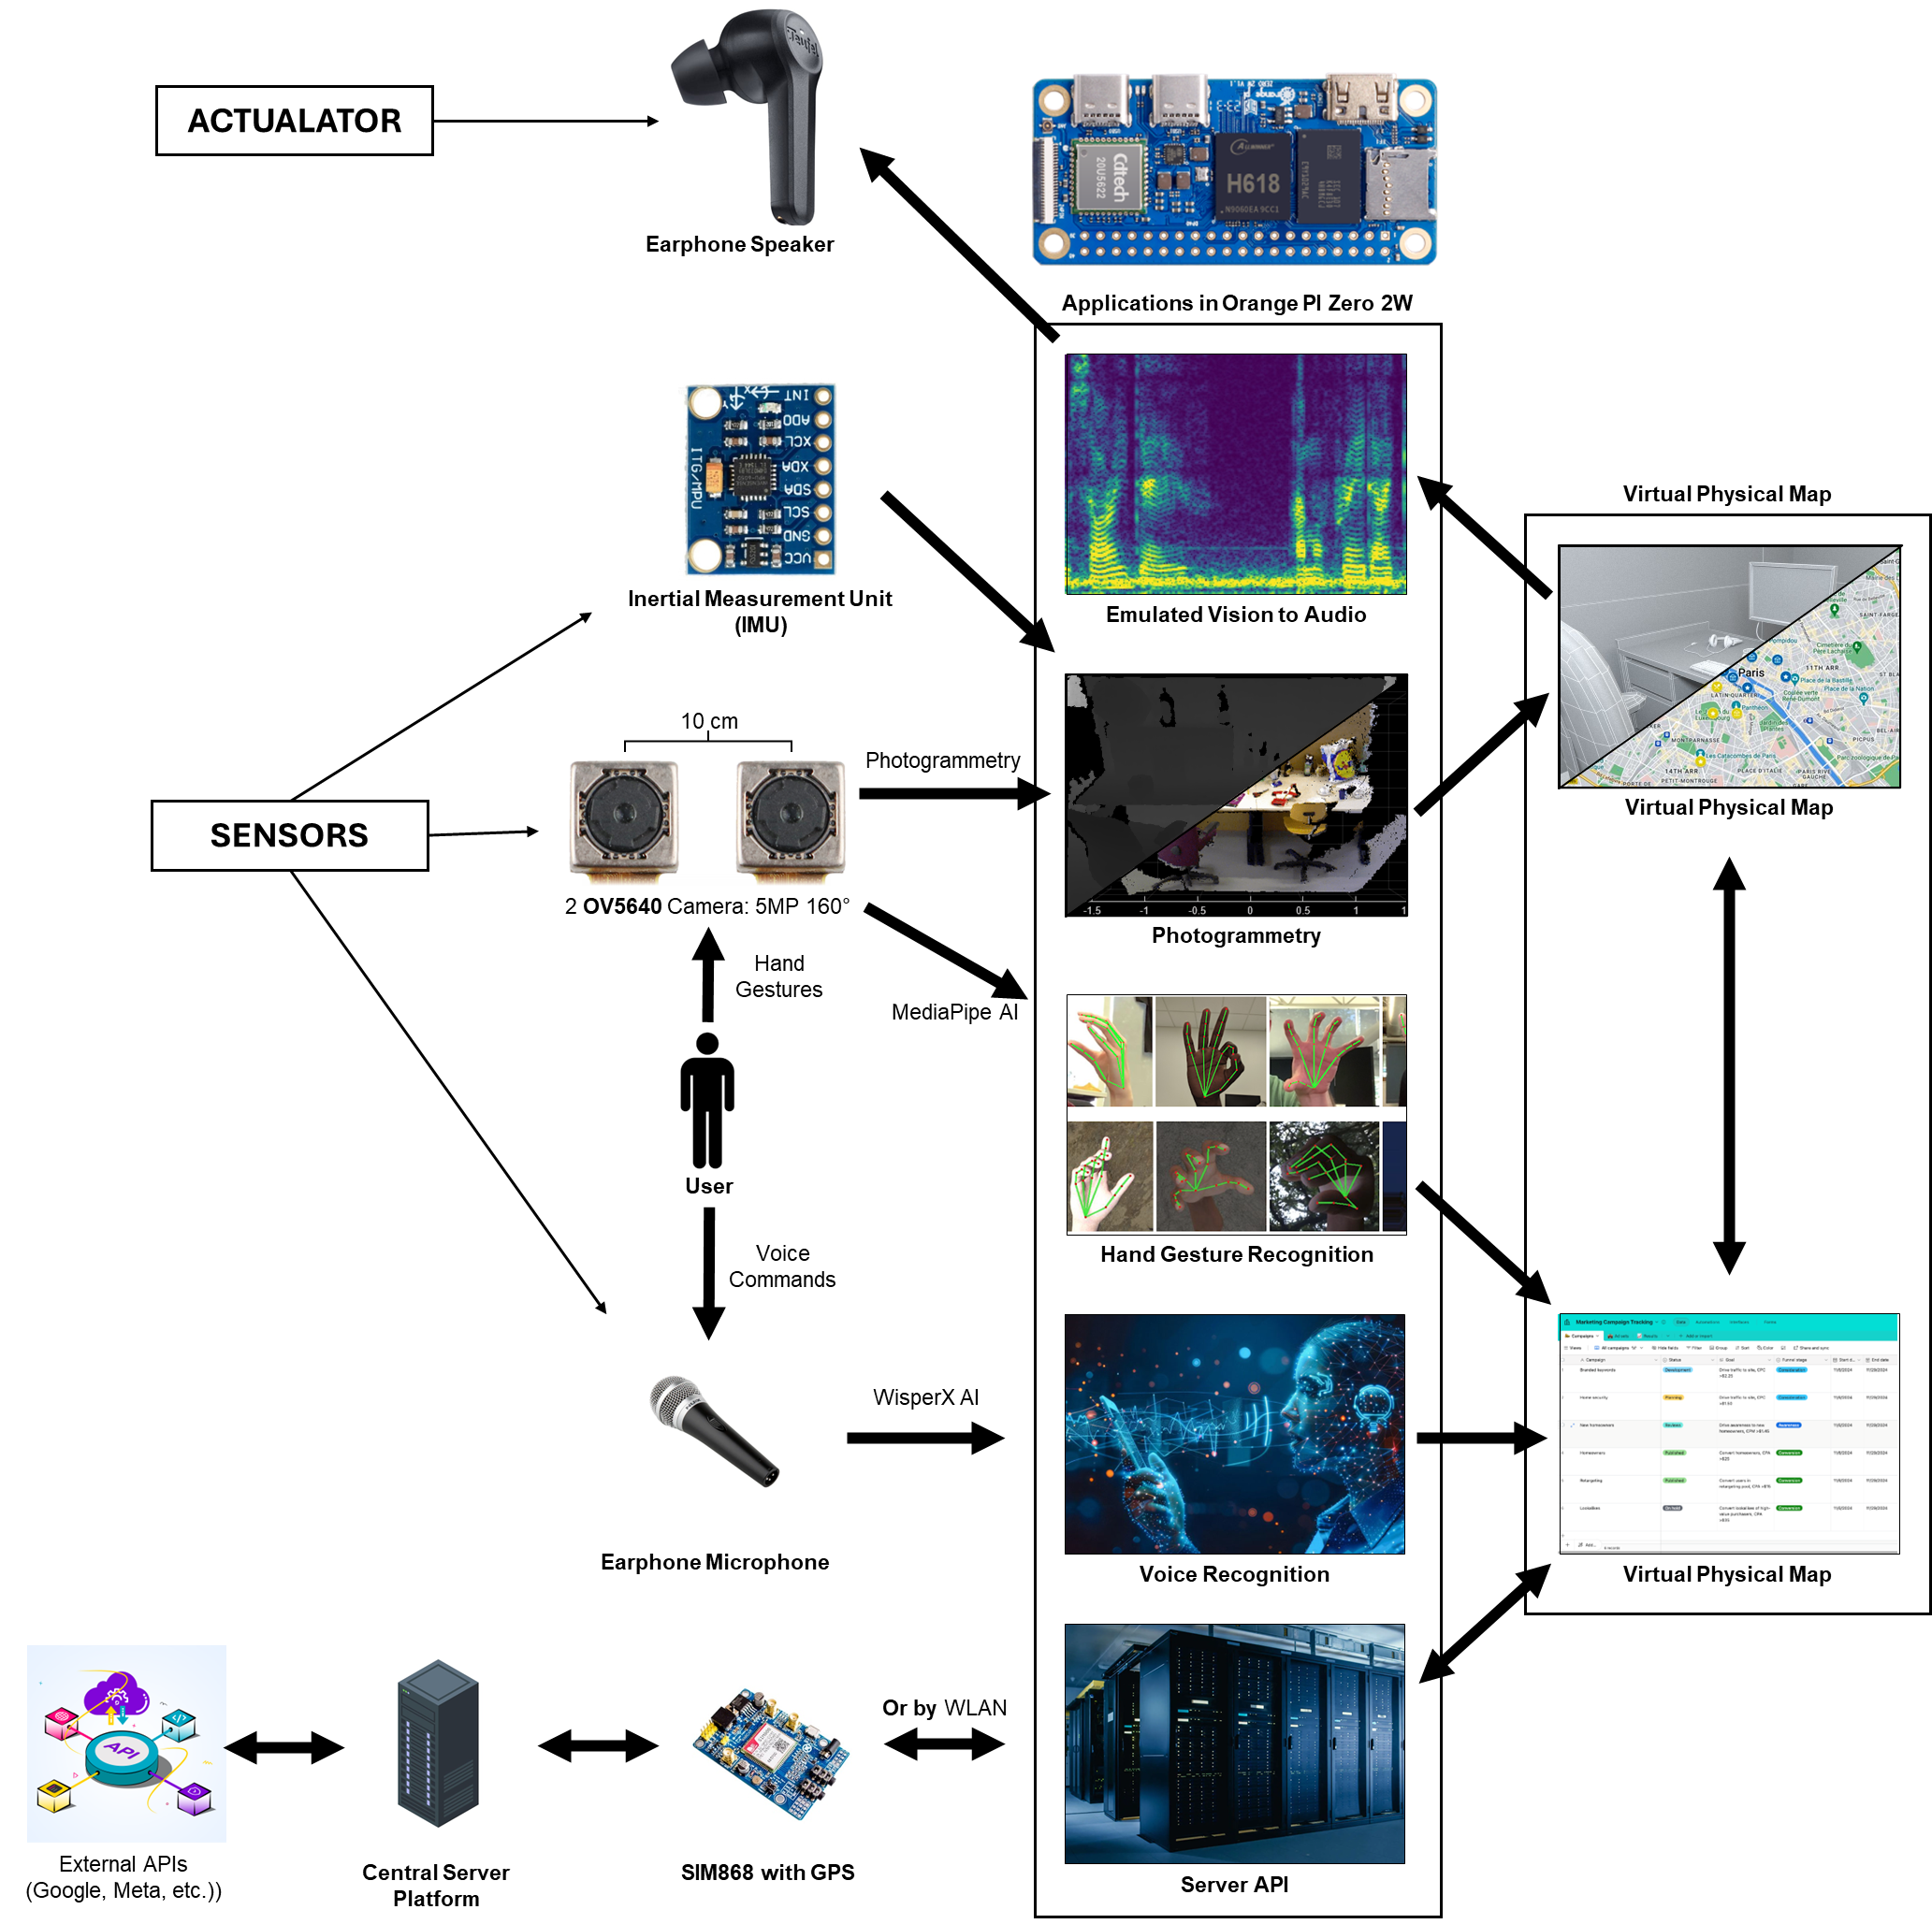
ACTUALATOR
Earphone Speaker
Applications in Orange PI Zero 2W
Virtual Physical Map
Inertial Measurement Unit
(IMU)
Emulated Vision to Audio
10 cm
Photogrammetry
SENSORS
Virtual Physical Map
2 OV5640 Camera: 5MP 160°
Photogrammetry
Hand
Gestures
MediaPipe AI
User
Voice Commands
Hand Gesture Recognition
WisperX AI
Earphone Microphone
Voice Recognition
Virtual Physical Map
Or by WLAN
External APIs
(Google, Meta, etc.))
Central Server
Platform
SIM868 with GPS
Server API

Slide 18
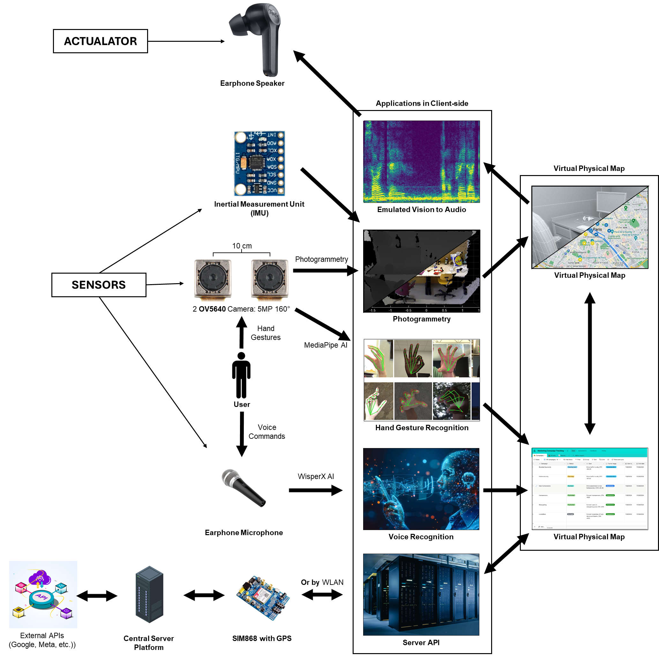

Slide 19
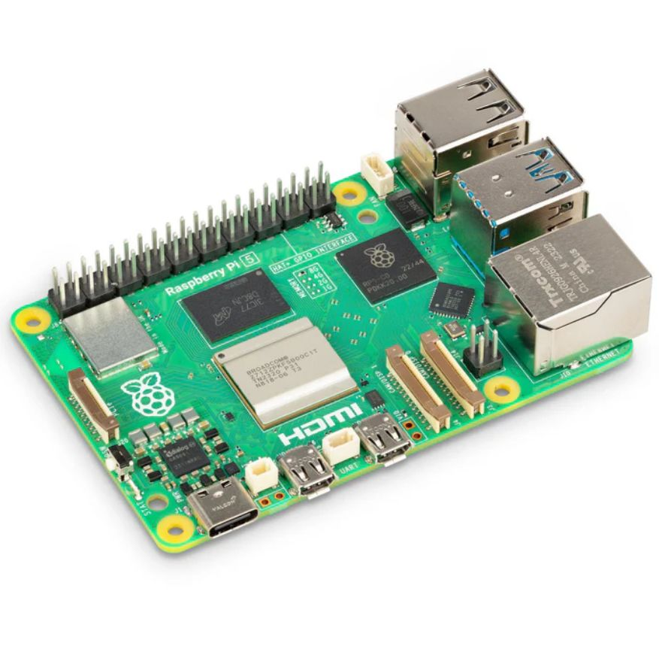
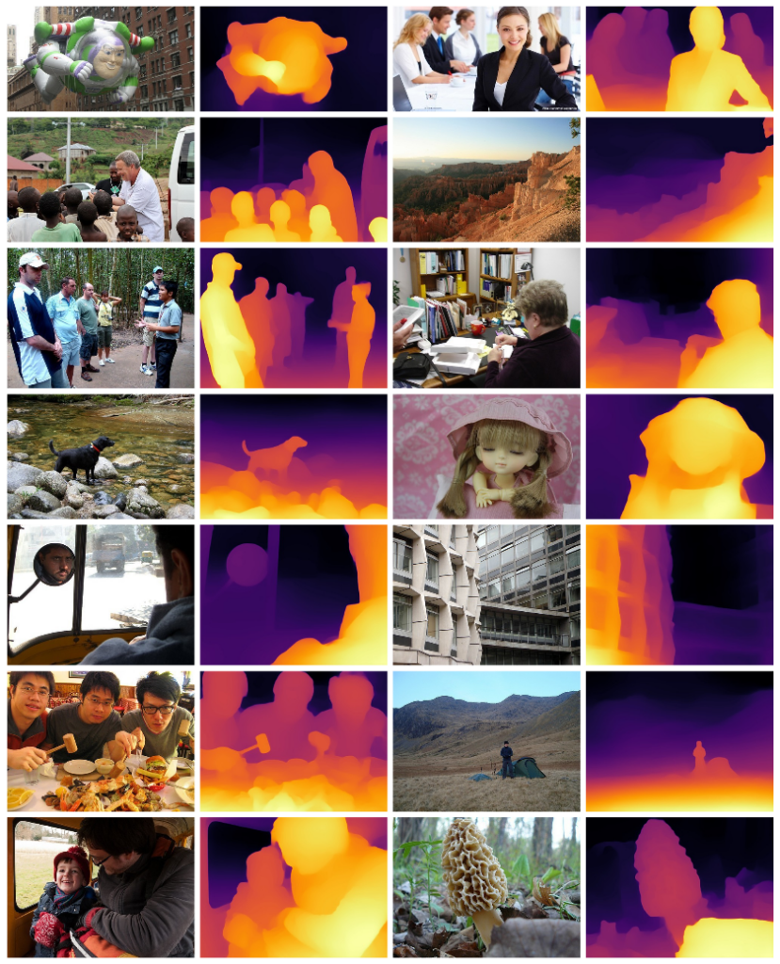

ACTUALATOR
Earphone Speaker
Applications in Raspberry Pi 5
Virtual Physical Map
Inertial Measurement Unit
(IMU)
Emulated Vision to Audio
Photogrammetry
SENSORS
Virtual Physical Map
OV5640 Camera: 5MP 160°
Photogrammetry
Hand
Gestures
MediaPipe AI
User
Voice Commands
Hand Gesture Recognition
WisperX AI
Earphone Microphone
Voice Recognition
Virtual Physical Map
Or by WLAN
External APIs
(Google, Meta, etc.))
Central Server
Platform
SIM868 with GPS
Server API

Slide 20
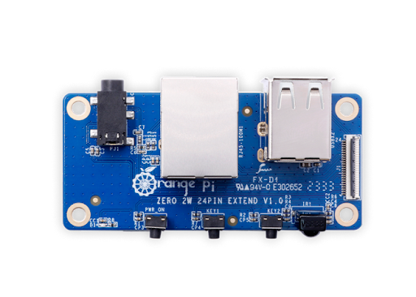




10 cm
24 pin interface
USB Connection
2 OV5640 Camera: 5MP 160°
MPU 6050
Audio Jack Connection
Orange PI zero 2W (4GB)
Expansion Board
MicroSD Card
(OrangePI OS and App)
Stereo Earphone
UPS Module (5V/3A)
Power Supply
18650 Lithium batteries

